Slide 1

BUILDING E-PRESENCE
7-<number>

Slide 2
The focus of this chapter is on several learning objectives
The main functions of a Web site
The steps taken to build a Web site
The importance of planning a Web site
Factors in Web site structure
Web design criteria
What to consider before hiring a Web designer
7-<number>

Slide 3
What Does a Web Site Do?
Web site is a virtual storefront
The customers are cyber-customers
Emphasis is on
  Speed
  Efficiency
  Good response time
  Availability of procedures that expedite a sale
A Web site is basically a series of pages with links to other pages or other sites
7-<number>

Slide 4
Key Components of a Web Site
Homepage is the first page of a site that appears when one visits a URL address
Web page is a carrier of information reached by clicking a button/link on a homepage
Link is a connector that makes it possible to go to another Web page on the site or on the Internet, or go back to the homepage
Banner is a graphic display on a Web page, usually used for advertising
7-<number>

Slide 5
Web Site Benefits
Reach millions of customers quickly and reliably
Establish a presence in cyberspace
Leverage advertising costs
Reduce the cost of serving customers
Promote public relations
Reach international markets and customers
Test-market new product or services
7-<number>

Slide 6
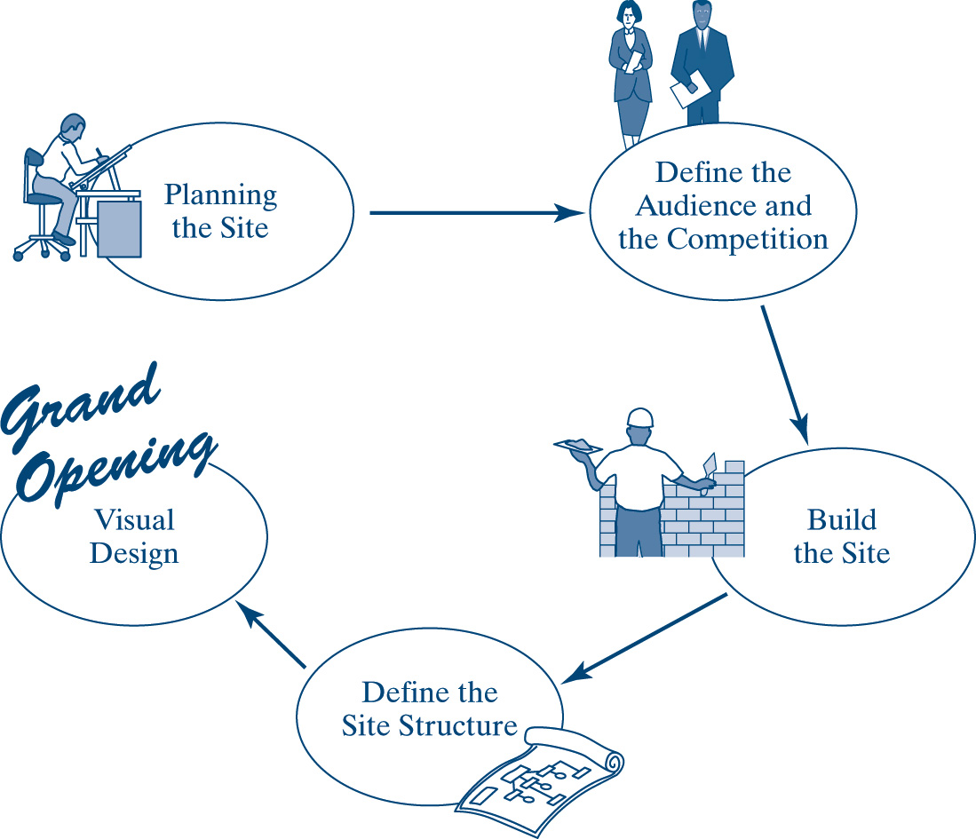
Site Building Life Cycle
7-<number>

Slide 7
Objectives of a Customized Web Site
Speed up the interactive process
Reduce human intervention to a minimum
Save time
Make buying and selling through the site cost-effective
7-<number>

Slide 8
Planning Stage
Provide for quick application development and deployment
Define site’s goals
  Determine who will be involved in defining the goals
  Determine if there is time or a need for formal definition
Decide on the site’s mission
  Short term and long term goal of the site
Who is the intended audience?
Why will people want to visit the stage?
How the site will tie up with inventory, control, database, personalizaton
7-<number>

Slide 9
Define the Audience and the Competition
Determining your audience, their goals and objectives
Generate a list of intended audiences
Identify what prospective customers want
Goal is to enhance site visitors’ experience
  Escorting them quickly to the merchandise
  Speed and responsiveness are crucial
  The seven-second rule
See how well the site matches users’ needs
Competitive analysis
  What other similar sites are doing
Prepare a design document
7-<number>

Slide 10
Build Site Content
What the site will contain
  Company logo
  Product catalog
  Bio of company
  order form
  Hit counter
  Customer forum
Content inventory is a list of the company activities (contents) that make up the Web site
Determine the order of priority of each function or department
The designer needs to determine the feasibility of each function
Content and functional requirements
7-<number>

Slide 11
Define the Site Structure
Focus is on creating good and easy to navigate site structure
Site structure is an organized layout of a merchant’s departments or functions that becomes the basis for the Web site
  Easy site navigation
  Well-laid-out pages and templates
  The structure that holds the entire site together
How much info each page will contain
How info is organized in a page
7-<number>

Slide 12
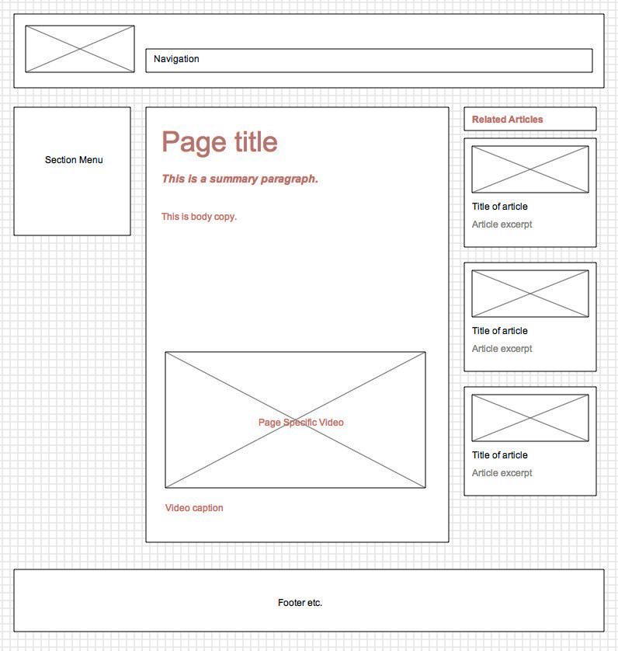
Architectural Blueprints of Site Contents
7-<number>

Slide 13
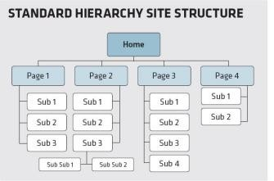
Architectural Blueprints of Site Contents
7-<number>

Slide 14
Develop the Visual Design
Find main goal, attracting and retaining visitors
Use a layout grid to show how well the elements fit together
Branding company’s logo on each page
Content is the critical part of a page
Establish look and feel of the site via page mock-ups
Personalization
  Tracking the user’s behavior
  Cookies are bits of code that sit in a user’s browser memory and identify the visitor to the Web site
7-<number>

Slide 15
Design Languages
Hypertext Markup Language (HTML)
  Text-based
  Standards
Java is another popular language for designing
Multimedia-enriched content
  Macromedia Flash and Shockwave
  Extensible Markup Language (XML)
  Vector Markup Language (VML)
7-<number>

Slide 16
Constructing Your Web Site
Storefront Building Service
Web-Hosting Service
  Web host representative meets with you and explains the aspects of Web design
  The web host begins to collect content from you to build a custom Web site
  Once the website passes the test, the firm begins to write the keywords and metatags and submits the Web site to leading search engines, Web directories, and industry sites
  A reputable web host also supports maintenance and future enhancements in a yearly contract or a long term agreement
Do It Yourself
7-<number>

Slide 17
Web Navigation Design
Creating user profiles
  Customer profile is a brief study of the type of person who might visit your Web site
Using scenarios
  Scenario is a situation that helps you view the navigation process and the site as a point of entry
What about cultural differences?
Design a user-friendly site
Design guidelines
7-<number>

Slide 18
Design Criteria
Appearance and quality design
  Quality assurance (QA) is a process used to check the readiness of a site before it is loaded on the Web
  Style guide is a template designed to measure the materials used to build the Web site
Public exposure
Viewability and Resolution
Consistency
Scalability
Security
Performance
Navigation and interactivity
7-<number>

Slide 19
Hiring a Web Designer
Do it yourself?
The budget
What to look for in a site developer
7-<number>

Slide 20
Why Web Site Projects Fail?
Unrealistic deadlines
Incompetent or inadequate staffing
Poor quality design
Changing requirements of the client
Filling Web positions
7-<number>

Slide 21
ADA Is Here!
ADA requires companies to adjust their physical environment to accommodate people with disabilities
Public support for ADA is increasing everywhere
Public pressure is mounting to bring people with handicaps and senior citizens into the world of the Internet
Make sure the Web site is ADA-compliant
7-<number>

Slide 22
Chapter Summary
Deciding how to design the site, what to include in it, how to organize content, and what security measures to incorporate are the most critical aspects of building an e-commerce infrastructure
Benefits of building a Web site
Steps in building a Web site
Defining the audience includes knowing who the users are as well as their goals and objectives
The focus of defining a site structure
Ways to build a Web site
Design criteria
ADA-compliance
7-<number>

